Slide 1
SEAPORT CHALLENGE
BY :- Codevils

Slide 2
Existing Problem
The given dataset in problem statement is multivariate and is inter-relational with missing key values and scaled down values . And the required
processing to performed is clustering and segmentation which is quite difficult to do in this data set which later raises complexity in deriving
Insights from data.

Slide 3
Proposed Solution
How it works:
1
Standardize and normalize data and fill-up missing values with mean and median methods.
2
Converting categorical data into numerical values using label encoder.
3
Implementing pie-plot scatter to derive relationships between variables.
4
Finally applying clustering on related data.

Slide 4
Workflow
STAGE 01
Importing Dataset
Standardizing using standard scalar function.
STAGE 03
Filling missing and string categorical values with statistical models.
STAGE 02
STAGE 04
STAGE 05
Plotting relationships
Clustering and segmentation

Slide 5
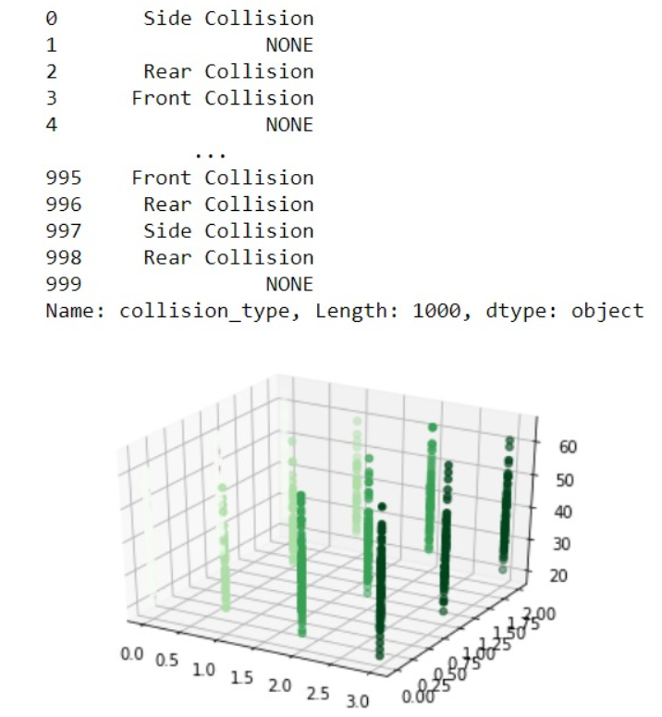
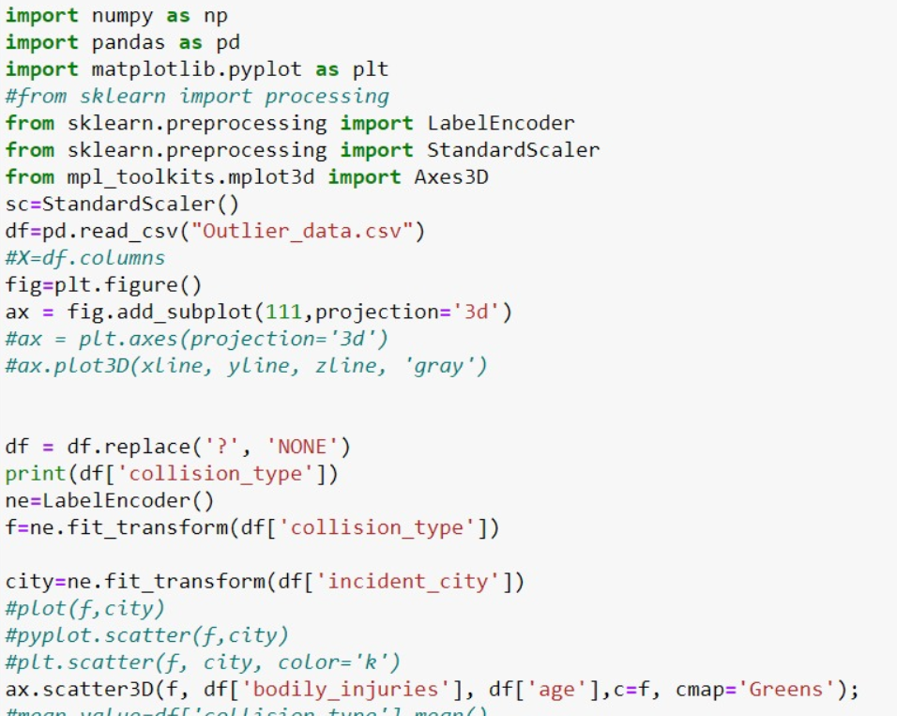
Technical Implementation

Slide 6
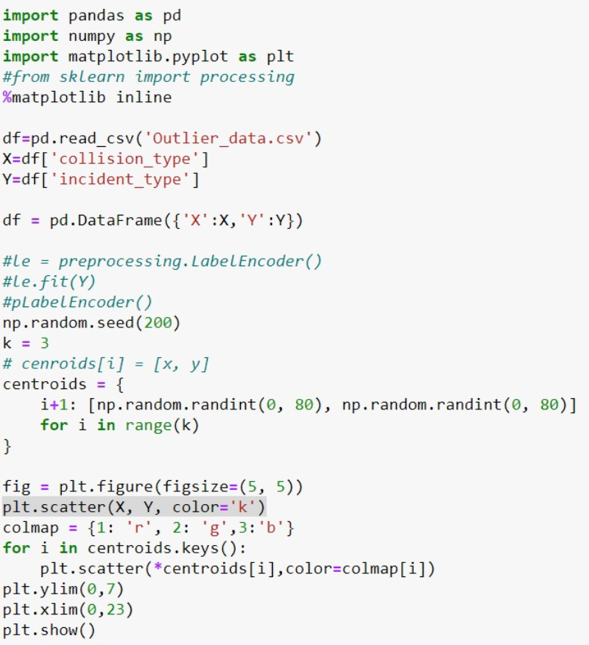
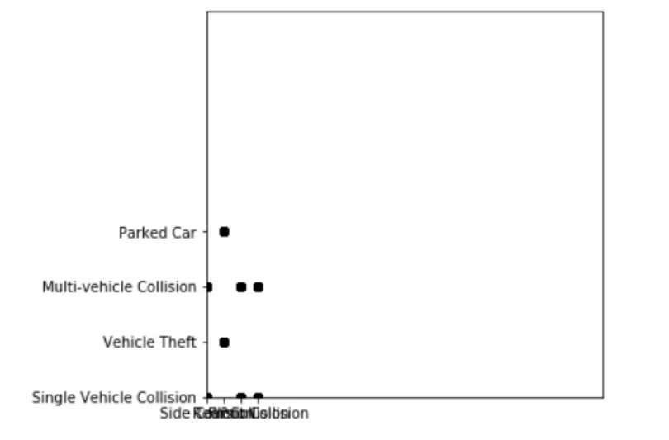

Slide 7
Business intelligence
Can accommodate in analytics approach in customer procurement and retention via viable concrete data achieved through above process.

Slide 8
Future Enhancements
In our above implementation we have used K-means clustering and tried agglomerative approach of clustering and we were unable to make fully reliable and relational clusters. But in our research we found two more efficient algorithms Heuristic Approach and BFR algorithm which we may apply in future for better and more accurate results.

Slide 9
THANK YOU

